Slide 1
VACCINE BOX MONITORING SYSTEM

Slide 2
CONTENTS
Introduction
Apparatus
Block diagram
usage
Explanation

Slide 3
Introduction
The purpose of the vaccine box monitoring system is to maintain product quality from the time of manufacture until the point of administration by ensuring that vaccines are stored and transported with in WHO-recommended temperature ranges.

Slide 4
Apparatus
ARDUINO_UNO
DHT11 SENSOR(humidity and temperature monitoring sensor)
LDR SENSOR(light intensity sensor)
ADXL345 SENSOR(acceleration)
BUZZER
BREAD BOARD
CONNECTING WIRES

Slide 5
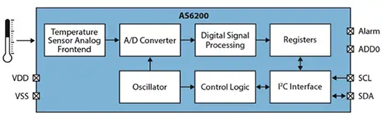
Block diagram

Slide 6
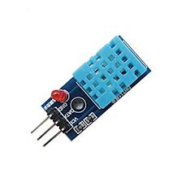
Usage
DHT11 SENSOR:
It gives analog output.
It used to find surrounding temperature and humidity.

Slide 7
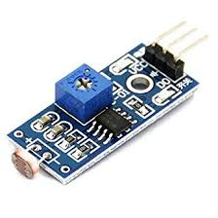
Continuation..
LDR SENSOR:
It gives digital output.
It is a light intensity detection sensor.

Slide 8
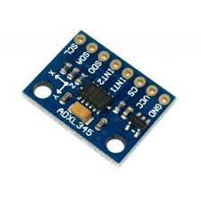
Continuation..
ADXL345:
The ADXL345 is a 3 axis accelerometer and there are two basic uses for this device.
Orientation :Determine which way is up using gravity.
Instantaneous force : Detect applied forces.

Slide 9
Explanation

